Slide 1
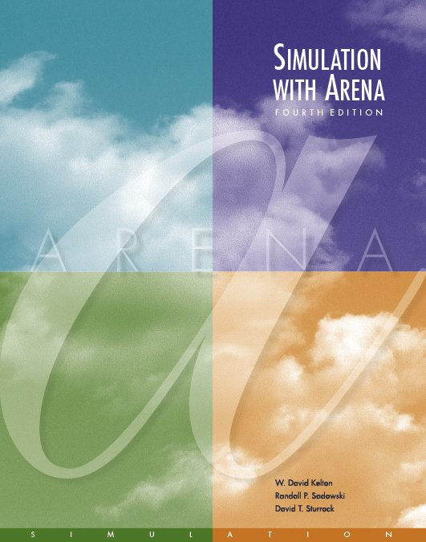
A Guided Tour Through Arena
Chapter 3
Last revision August 19, 2006

Slide 2
What We’ll Do ...
Start Arena
Load, explore, run an existing model
  Basically the same model as for the hand simulation in Chapter 2
  Browse dialogs and menus
  Run the model
  Look at results
Construct the same model from scratch
Use just these basic building blocks in a case study to address a real operational question
Tour menus, toolbars, drawing, printing
Help system
Options for running and control

Slide 3
Behavior of Arena
Arena is a true Windows application
  Appearance, operation, functions, are standard
  Interoperability with other software (MS Office, CAD)
  Interact, communicate with other software (Chapter 10)
Assume you already know basics of Windows:
  Disks, files, folders, paths
  Mousing, keyboarding
  Resizing, moving, maximizing, minimizing windows
  Menu operations
  Ctrl, Alt, Shift keys
  Cut, copy, paste
  Filling out dialog fields

Slide 4
Starting Up
Installing Arena – Appendix E
Locate icon or shortcut; double-click
  Or, Start > Programs > Rockwell Software > Arena 10.0 > Arena 10.0
  Licensed vs. Academic, Evaluation mode
See File, View, Tools, Help menus
  Other menus present if a model file is open
Toolbars with buttons
  Unless a model file is open, only New model file, Open model file, Template Attach/Detach, Context Help (click it, then click on buttons or menu items)
Tooltips – roll over toolbar buttons for names
Quitting Arena: File > Exit or Alt+F4 or top right button

Slide 5

Opening an Existing Model
File > Open … or button
  Navigate to desired disk/directory
  Click > Open or double-click Model 03-01.doe
  Book models: Rockwell Software\Arena 10.0\Book Examples
  More examples: Rockwell Software\Arena 10.0\Examples
Model window (usually on right side of Arena window)
  Where model is built
  Resize, maximize, minimize, scroll/pan, zoom
  Can have multiple model windows open at once
Cut, Copy, Paste within Arena, and between Arena and other applications (when sensible)
Why the .doe default extension to Arena model filenames?

Slide 6
Flowchart and Spreadsheet Views
Model window split into two views
  Flowchart view
    Graphics
    Process flowchart
    Animation, drawing
    Edit things by double-clicking on them, get into a dialog
  Spreadsheet view
    Displays model data directly
    Can edit, add, delete data in spreadsheet view
    Displays all similar kinds of modeling elements at once
  Many model parameters can be edited in either view
  Horizontal splitter bar to apportion the two views
  View > Split Screen (or push ) to see both flowchart and spreadsheet views (otherwise, get just flowchart view)

Slide 7
Project Bar
Usually down the left edge of Arena window
Hosts panels with modeling building blocks: modules
  Both flowchart and spreadsheet modules
Displays one panel at a time
  Switch to different panels via horizontal buttons
  Panels for Basic Process, Reports (after running), Navigate (to different views within a model or to different hierarchical submodels, thumbnail), … others can be attached (Template Attach button ) for different modeling levels, specialties
Usually docked to left edge but can move, float
Hide it via View > Project Bar or its own small

Slide 8
Status Bar
At very bottom of Arena window
Displays various information sensitive to status
  Coordinates of cursor in “worldspace”
  Simulation clock value, replication number being executed, number of replications to be done, when simulation is running
Hide by clearing (unchecking) View > Status Bar

Slide 9






Moving Around, Up, Down in Flowchart View of Model Window
Underlying world space for model
  (x, y) coordinates, arbitrary units (thousands in each direction)
Pan with scroll bars, arrow keys, thumbnail
Zoom in (down): or + key or thumbnail
Zoom out (up): or – key or thumbnail
See all at min altitude: or * key
Named views
  Save a pan/zoom view for different parts of model
  Assign a Hot key (case-sensitive)
  Access via View > Named Views … or ? key or
Display grid ( ), snap to grid ( ) toggles
Rulers, alignment, guides, glue – see text
To navigate via keyboard, the model window must be active ... click in it.

Slide 10
Modules
Basic building blocks of a simulation model
Two basic types: flowchart and data
Different types of modules for different actions, specifications
“Blank” modules are on the Project Bar
  To add a flowchart module to your model, drag it from the Project Bar into the flowchart view of the model window
    Can have many instances of the same kind of flowchart module in your model
  To use a data module, select it (single-click) in the Project Bar and edit in the spreadsheet view of the model window
    Only one instance of each kind of data module in your model, but it can have many entries (rows) in the spreadsheet view
    Can edit via dialog – double-click on number in leftmost column

Slide 11
Flowchart Modules
Describe dynamic processes
  Nodes/places through which entities flow
  Typically connected to each other in some way
Basic Process panel flowchart module types:
  Create, Dispose, Process, Decide, Batch, Separate, Assign, Record
Other panels – many other kinds
Shape like flowcharting (also use colors for hints)
Two ways to edit
  Double-click to open up, then fill out dialogs
  Select (single-click) a module type in model or Project Bar, get all modules of that type in the spreadsheet view

Slide 12
Data Modules
Set values, conditions, etc. for whole model
  No entity flow, no connections
Basic Process panel data module types:
  Entity, Queue, Resource, Variable, Schedule, Set
Other panels – many other kinds
Icons in Project Bar look like little spreadsheets
To use a data module, select it (single-click) in the Project Bar, edit in spreadsheet view
  Can edit via dialog – double-click in leftmost column, or right-click and select Edit via Dialog
  Double-click where indicated to add new row
  Right-click on row, column to do different things
Only one instance of each kind of data module in a model
  But each one can have many entries (rows)

Slide 13
Relations Among Modules
Flowchart and data modules are related via names for objects
  Queues, Resources, Entity types, Variables … others
Arena keeps internal lists of different kinds of names
  Presents existing lists to you where appropriate
  Helps you remember names, protects you from typos
All names you make up in a model must be unique across the model, even across different types of modules

Slide 14
Internal Model Documentation
Data Tips on modules, graphics – hover mouse over object to see
  Default part – generic info on object (name, type)
  User-defined part – right-click on object, select Properties, enter text under Property Description
  Toggle display of Data tips via View > Data Tips
Project Description – Run > Setup > Project Parameters, enter text under Project Description
Model Documentation Report – Tools > Model Documentation Report
  Generates HTML file with model details (can choose which kinds of details to include)

Slide 15
Browsing Through Model 3-1
Open Model 03-01.doe (in Book Examples folder)
Three flowchart modules (Create, Process, Dispose)
Entries in three data modules (Entity, Queue, Resource)
Animation objects
  Resource animation
  Two plots
  Some (passive) labels, artwork

Slide 16
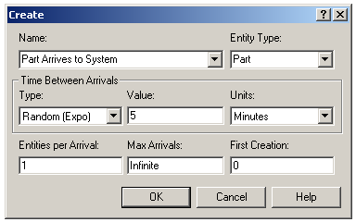
The Create Flowchart Module
“Birth” node for entities
Gave this instance of the Create-type module the Name Part Arrives to System
  If we had other Create modules (we don’t) they’d all have different Names
Double-click on module to open property dialog:

Slide 17
The Create Flowchart Module (cont’d.)
Name – for module (type it in, overriding default)
Entity Type – enter a descriptive name
  Can have multiple Entity Types with distinct names
Time Between Arrivals area
  Specify nature of the time separating consecutive arrivals
  Type – pull-down list with several options
  Value – depends on Type … for Random (Expo) is mean
  Units – time units for Value
Entities per Arrival – constant, random variable, very general “Expression” (more later …)
Max Arrivals – choke off arrivals (from this source) after this many entities
First Creation – time of first arrival (need not be 0)

Slide 18
Editing Flowchart Modules in the Spreadsheet View
Alternative to dialog for each instance of a module type
See all instances of a module type at once
  Convenient for seeing, editing lots of things at once
Selecting a module in either flowchart or spreadsheet view also selects it in the other view
Click, double-click fields to view, edit
Right-click in row to Edit via Dialog, define a user Data Tip (via Properties)
Right-click in expression fields to get Expression Builder for help in constructing complex expressions with Arena variables (more later …)

Slide 19
The Entity Data Module
A data module, so edit in spreadsheet view only
View, edit aspects of different Types of entities in your model (we have just one Type, Part)
Pull-down lists activated as you select fields
Our only edit – Initial Picture for animation
  We picked Picture.Blue Ball from the default list

Slide 20
The Process Flowchart Module
Represents the machine, including the resource, queue, and entity delay time (processing)
Enter Name – Drilling Center
Type – picked Standard to define logic here rather than in a submodel (more later …)
Report Statistics check box at bottom
  To get utilizations, queue lengths, queue waiting times, etc.

Slide 21
The Process Flowchart Module (cont’d.)
Logic area – what happens to entities here
  Action
    Seize Delay Release – entity Seizes some number of units of a Resource (maybe after a wait in queue), Delay itself there for the processing time, then Release the units of the Resource it had Seized – we chose this option
    Could just Delay entity (red traffic light) – no Resources or queueing
    Could also Seize Delay (no Release … Release downstream)
    Could also Delay Release (if Resource had been Seized upstream)
    Priority for seizing – lower numbers mean higher priority
    Different Action choices could allow stringing together several Process modules for modeling flexibility
  Resources – define Resource(s) to be seized, released
    Double-click on row to open subdialog
    Define Resource Name, Quantity of units to be Seized/Released here
    Several Resources present (Add) – entities must first Seize all

Slide 22
The Process Flowchart Module (cont’d.)
Delay Type – choice of probability distributions, constant or general Expression (more later …)
Units – time units for the delay (don’t ignore)
Allocation – how to “charge” delay in costing (more later …)
Prompts on next line – change depending on choice of Delay Type – specify numerical parameters involved
Can also edit in spreadsheet view
  Subdialogs (e.g., Resource here) become secondary spreadsheets that pop up, must be closed

Slide 23
The Resource Data Module
Defining the Drill Press Resource in the Process module automatically creates an entry (row) for it in the Resource data module
Can edit it here for more options
  Type – could vary capacity Based on Schedule instead of having a Fixed Capacity
    Would define the Schedule in the Schedule data module … later
  Failures – could cause resource to fail according to some pattern
    Define this pattern via Failure data module (Advanced Process panel) … later

Slide 24
The Queue Data Module
Specify aspects of the queues in the model
  We only have one, named Drilling Center.Queue (the default name given the Process name)
Type – specifies queue discipline or ranking rule
  If Lowest or Highest Attribute Value, then another field appears where you specify which attribute
Shared – it this queue will be shared among several resources (later …)
Report Statistics – check for automatic collection and reporting of queue length, time in queue

Slide 25
Animating Resources and Queues
Got queue animation automatically by specifying a Seize in the Process module
  Entity pictures (blue balls) will line up here in animation
Don’t get Resource animation automatically
  To add it, use Resource button in Animate toolbar … get Resource Picture Placement dialog
    Identifier – link to Resource name in pull-down list
    Specify different pictures for Idle, Busy state
      For pre-defined artwork, Open a picture library (.plb filename extension)
      Scroll up/down on right, select (single-click) a picture on right, select Idle or Busy state on left, then to copy the picture
  To edit later, double-click on picture in flowchart view

Slide 26
The Dispose Flowchart Module
Represents entities leaving model boundaries
Name the module
Decide on Record Entity Statistics (average, maximum time in system of entities exiting here, costing information)
Check boxes for statistics collection and reporting:
  Most are checked (turned on) by default
  Little or no modeling effort to say yes to these
  But in some models can slow execution markedly
  Moral – if you have speed problems, clear these if you don’t care

Slide 27
Connecting Flowchart Modules
Establish (fixed) sequence of flowchart modules through which entities flow
To make a connection
  Connect (Object > Connect), cursor becomes cross hairs
  Click on exit point from source module, then entry point on destination module
    Green, red boxes light up to aid in hitting exit, entry points
  Intermediate clicks for non-straight line in segments
To make many connections
  After each connection, right-click in blank space, select Repeat Last Action from pop-up menu
  Or, double-click on , place multiple connections (no right-click needed), right-click or Esc to end

Slide 28
Connecting Flowchart Modules (cont’d.)
Object menu toggles
  Auto-Connect – automatically connect entry point of newly placed module from exit point of selected module
  Smart Connect – force segments to horizontal/vertical
  Animate Connectors – show entities moving along connectors (zero time for statistics collection)
Move entry/exit points relative to their module
  Right-click on entry/exit point
  Select Allow Move from pop-up
  Drag entry/exit point around

Slide 29
Dynamic Plots
Trace variables, queues as simulation runs – a kind of “data animation”
Disappear after run is ended (to keep, must save data, postprocess via Output Analyzer – later)
Plot button from Animate toolbar… “Add” for
  Expression to plot (help via Expression Builder … later)
  Min/Max y-axis values (initially guesses, maybe revise)
    Arena can do this automatically and dynamically in Plot dialog
  Number of “corners” to show (# History Points) at a time
  Stepped option (for piecewise-constant curves)
  Colors
In Plot dialog – Time Range (x axis, Base Time Units), cosmetics, automatic scaling options
Drop plot in via crosshairs (resize, move later)

Slide 30
Dressing Things Up
Add drawing objects from Draw toolbar
  Similar to other drawing, CAD packages
  Object-oriented drawing tools (layers, etc.), not just a painting tool
Add Text to annotate things
  Control font, size, color, orientation

Slide 31
Setting the Run Conditions
Run > Setup menu dialog – five tabs
  Project Parameters – Title, your name, Project Description, output statistics
  Replication Parameters
    Number of Replications
    Initialization options Between Replications
    Start Date/Time to associate with start of simulation
    Warm-up Period (when statistics are cleared)
    Replication Length (and Time Units)
    Base Time Units (output measures, internal computations)
    Hours per “Day” (convenience for 16-hour days, etc.)
    Terminating Condition (complex stopping rules)
  Tabs for animation speed, run control, reports, array sizes
Terminating your simulation:
  You must specify – part of modeling
  Arena has no default termination
  If you don’t specify termination, Arena will usually keep running forever

Slide 32



Running It
Plain-vanilla run: Click from Standard toolbar (like audio/video players)
  First time or after changes: Check
  Enters run mode — can move around but not edit
  Speed up (> on keyboard) or slow down (<) animation display
  When done, asked if you want to see summary reports
  Click to get out of run mode (can’t edit until you do)
  Can pause run with or Esc key
Other run control, viewing, checking options

Slide 33
Viewing the Reports
Click Yes in the Arena box at the end of the run
  Opens up a new reports window (separate from model window) inside the Arena window
  Project Bar shows Reports panel, with different reports (each one would be a new window)
  Remember to close all reports windows before future runs
Default installation shows Category Overview report – summarizes many things about the run
  Reports have “page” to browse ( and )
  Also, “table contents” tree at left for quick jumps via ,
Times are in Base Time Units for the model

Slide 34
Viewing the Reports – Examples
Entity → Time → Total Time → Part:
  Avg. time in system was 6.4397 min., max was 12.6185
Resource → Usage → Instantaneous Utilization → Drill Press:
  Utilization was 0.9171 (busy 91.71% of the time)
Process → Other → Number In → Drilling Center:
  During the run, 7 parts entered the Drilling Center
Process → Other → Number Out → Drilling Center:
  5 entities left the Drilling Center (so were produced)
Entity → Time → Wait Time → Part:
  Avg. wait time in all queues was 3.0340 min. (counts only entities that left the system, but Queue → Time → Waiting Time → Drilling Center.Queue counts all entities that left this queue, so can differ)
Entity → Other → Wip → Part:
  Average Work in Process was 1.7060, max WIP was 4

Slide 35
Types of Statistics Reported
Many output statistics are one of three types:
  Tally – avg., max, min of a discrete list of numbers
    Used for discrete-time output processes like waiting times in queue, total times in system
  Time-persistent – time-average, max, min of a plot of something where the x-axis is continuous time
    Used for continuous-time output processes like queue lengths, WIP, server-busy functions (for utilizations)
  Counter – accumulated sums of something, usually just nose counts of how many times something happened
    Often used to count entities passing through a point in the model

Slide 36
More on Reports and their Files
Reports we just saw – based on a MS Access database that Arena writes as it runs
  Can be saved and viewed later
  Viewing within Arena done via Crystal Reports to query the Access database
Arena also produces a plain-text summary report (.out filename extension)
  Was in previous versions of Arena, underlying SIMAN simulation language
  Fairly cryptic, but gives quick view of lots of output data
Get multiple reports for multiple replications
“Half Width” columns – for confidence intervals on outputs in long-run simulations … more later

Slide 37
Build It Yourself
Build same model from scratch – details in text
Handy user-interface tricks:
  Right-click in an empty spot in flowchart view – small box of options, including Repeat Last Action … useful in repetitive editing like placing lots of the same module type
  Ctrl+D or Ins key – duplicates whatever’s selected in flowchart view, offsetting it a bit … drag elsewhere, edit
Open a new (blank) model window – name it, save it, maybe maximize it
Attach modeling panels you’ll need to Project Bar if they’re not already there

Slide 38
Build It Yourself (cont’d.)
Place and connect flowchart modules
Edit flowchart and data modules as needed
  Experiment with Expression Builder – right-click in expression field
Add plots, animation, artwork
Add named views (? key or View > Named Views or ), with hot key (case-sensitive)
Edit Run > Setup dialog
“Displays” in text
  Compact way of saying what needs to be done in a dialog
  Omits Arena defaults
  Shows completed dialogs, table of actions needed

Slide 39
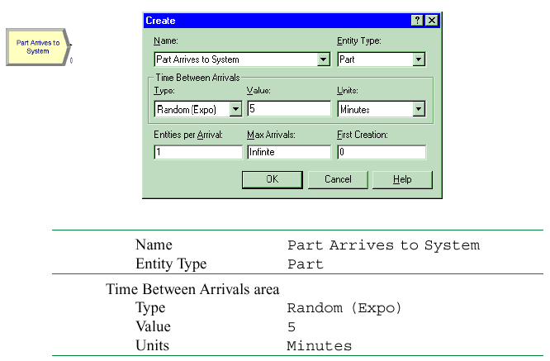
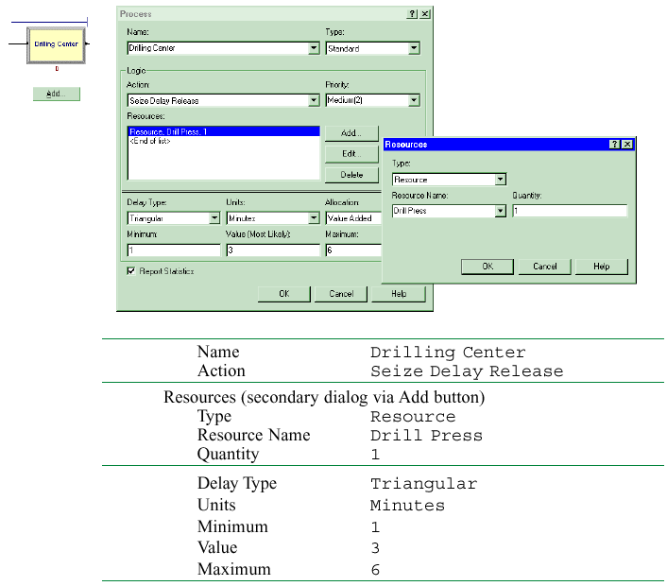
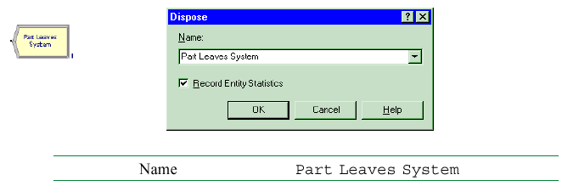
Displays for Create, Process, Dispose Modules

Slide 40
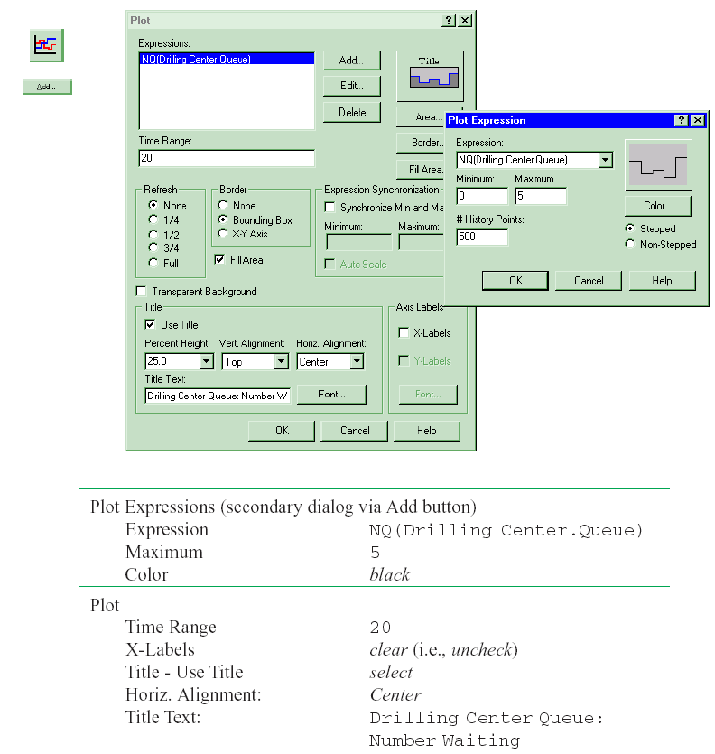
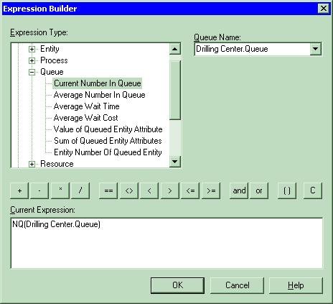
Displays for Queue-Length Plot, its Expression-Builder Entry
Right-click
here, then click
Build Expression,
to get this

Slide 41
Case Study: Specialized Serial vs. Generalized Parallel Processing
Loan applications go through four steps
  Check credit, prepare covenant, price loan, disburse funds
  Each step takes expo (1 hour)
  Applications arrive with expo (1.25 hour) interarrival times
    First application arrives at time 0
  Run for 160 hours
  Watch avg, max no. applications in process (WIP),
  avg, max total time in system of applications
  Four employees, each can do any process step
Serial specialized processing or generalized parallel processing?
  What’s the effect of service-time variability on the decision?

Slide 42
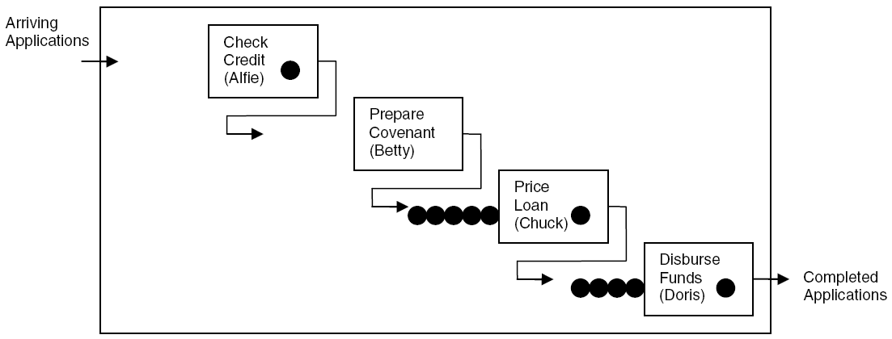
Case Study: Model 3-2,
Specialized Serial Processing
Betty’s idle but Chuck and Doris are overloaded – wasted capacity?
File Model 03-02.doe
Create module – similar to Model 3-1 except expo mean, time units
  Set Entity Type to Application

Slide 43
Case Study: Model 3-2,
Specialized Serial Processing (cont’d.)
Four Process modules – similar to Model 3-1
  Four separate Resources
  Expo process time must be entered as Expression (via Expression builder)
Dispose module similar to Model 3-1
Default entity picture (report) is OK
Default Resource animations almost OK
  Make Idle picture same as Busy
  Select correct Resource name in Identifier field
Queue, Resource data modules OK
Plot WIP – use Expression builder to find EntitiesWIP(Application)
Fill in Run > Setup, lengthen queue animations

Slide 44
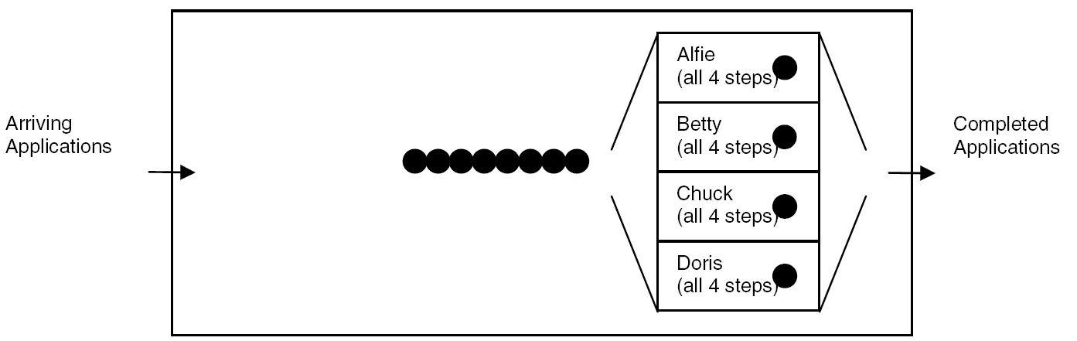
Case Study: Model 3-3,
Generalized Parallel Processing
Only one place to queue, but processing times are longer – sum of four IID expo (1 hour) times
File Model 03-03.doe
Create, Dispose, plot, Run > Setup almost same
  Just change some labels, etc.

Slide 45
Case Study: Model 3-3,
Generalized Parallel Processing (cont’d.)
Replace four earlier Process modules with just a single Process module
  One Resource (Loan Officer), but four units of it
  Still set Quantity to 1 since application just needs 1 officer
  Delay type – Expression
  EXPO(1) + EXPO(1) + EXPO(1) + EXPO(1)
    Why not 4*EXPO(1)?
Modify Resource Animation for four units
  Open Model 3-2 Resource Animation to get Resource Picture Placement window, open Idle picture
  Duplicate white square three times, realign; copy to Busy
  In model window, double-click Seize Area, then Add three
  Still not completely accurate animation (order) – need Sets

Slide 46
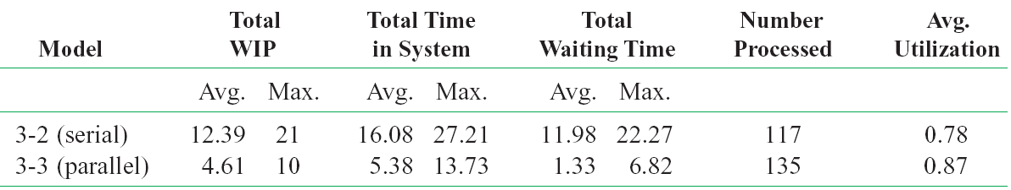
Case Study:
Compare Model 3-2 vs. 3-3
Caution: This is from only one replication of each configuration, so there’s output variability
  Are differences statistically significant? (Exercise 6-19)

Slide 47
Case Study:
Effect of Task-Time Variability
Is parallel always better than serial under any conditions?
  Many aspects could matter
  Focus on task-time variability
Now, each task time ~ expo (1 hour)
  Highly variable distribution
    P(task time < 10 minutes) = 0.15
    P(task time > 2 hours) = 0.14
  In serial config., just one large task time congests greatly
    In parallel config. it would also congest, but probably not by as much since the other three tasks are probably not all large too
Other extreme – each task time is exactly 1 hour
  Leave interarrival times as expo (1.25 hours)
  Models 3-4 (serial), 3-5 (parallel) – alter Process modules
See text

Slide 48
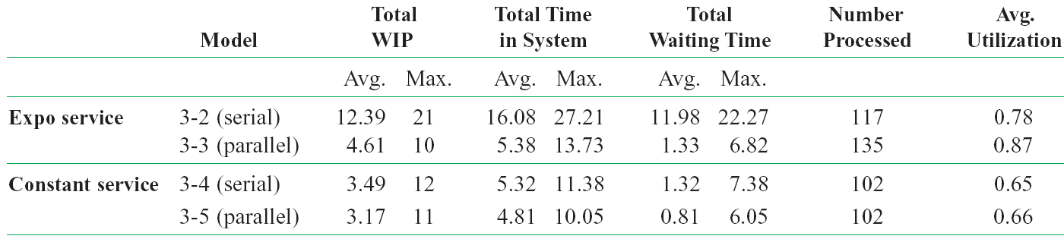
Case Study:
Effect of Task-Time Variability (cont’d.)
For constant service, parallel improvement appears minor
  Maybe not even statistically significant (Exercise 6-19)
Some further questions
  In parallel, work is integrated/generalized, so would it be slower per task? (Exercises 3-13, 6-20)
  Effect of worker breaks? (Chapters 4, 5)
  Differences statistically significant? (Exercises 6-19, 6-20)

Slide 49
More on Menus – File Menu
Model-file management
Template attach/detach
DXF import (from CAD packages), Visio import
Color palettes
Printing
E-mail open model file
Recent models
Exit from Arena

Slide 50
Edit Menu
Undo/Redo
Cut/Copy/Paste
Paste Link (create OLE link)
Duplicate, Delete selection
Select/Deselect All
Entity Pictures – change content, definition of pictures presented in Entity data module
Calendar Schedules – specify complex time patterns in hierarchies (weeks are made of days, which are made of shifts, etc.), exceptions (holidays), view composite net effect

Slide 51
Edit Menu (cont’d.)
Find – searches all modules and animation objects for a text string … useful for finding wrong names, typos after an error message from Arena
Properties – display internal Arena object properties
Links – to link to other files (spreadsheets, sounds, etc.)
Insert New Object/Control – from other applications (e.g., graphics, VBA, ActiveX)
Object – edit object imported from another application

Slide 52
View Menu
Zooming – discussed before
  Zoom Factor – step size when zooming
Views – canned Arena views of flowchart view
Named Views – define, change, use views
Rulers, Grid, Guides, Snap, Glue – align objects
  Page breaks – shows page breaks if printed
Data Tips – toggles display of Data Tips
Connector Arrows – show entity-flow direction
Layers – which objects show up in which mode

Slide 53
View Menu (cont’d.)
Split Screen – if checked, shows both flowchart, spreadsheet views
Runtime Elements Bar – if checked, displays window allowing choice of what is displayed during execution
Toolbars – decide which toolbars show up
Project/Status Bar – toggle to show up or not
Debug Bar – if checked, displays window of debugging tools during run

Slide 54
Tools Menu
Arena NewsFlash – internet feed for updates, etc.
Arena Symbol Factory –graphics in categories, use to create graphical symbols for animation
Separate applications for modeling, analysis
  Input Analyzer – fit probability distributions for input, using field-collected data
  Process Analyzer – run, compare many “scenarios” at once
    Also Output Analyzer … not on menus ... start from Start menu
Special “editions” of Arena (Contact Center, etc.) – depends on licensing
Model Documentation Report – generate HTML file with many details of this model

Slide 55
Tools Menu (cont’d.)
Import/Export model to/from Database – bring in, save model details to Excel or Access
OptQuest for Arena – separate application that “takes over” running of the model to search for an optimal scenario
AVI Capture – record actions (editing, animation) to .avi file for playback
Macro – create Visual Basic macros (mini programs), VB editor ... more in Chapter 10
Options – control many aspects of how Arena works, looks

Slide 56
Arrange Menu
For modeling, graphics objects – first select object(s)
Bring object to Front, Send to Back – “stacking”
Group, Ungroup objects (move together, etc.)
Flip around Vertical, Horizontal line
Rotate object (90° clockwise)
Align objects on top, bottom, left, or right edges
Distribute objects evenly (horizontally, vertically)
Flowchart Alignment – arrange flowchart modules (horizontally, vertically)
Snap Object to Grid – for the selected object(s)
Change Object Snap Point on snapped object

Slide 57
Object Menu
Connect tool – changes cursor to cross hairs
  Hit twice for repeated connections, right-click or Esc to exit
Auto-Connect new module to selected module
Smart Connect – new connections in horizontal/vertical segments only
Animate Connectors –show entities moving (at infinite speed for statistics collection)
Animate At Desktop Color Depth – use desktop color depth (could slow run)
  If not checked, color is 8-bit (256 colors), runs faster
Submodel – define and manage hierarchical submodels, useful for large, complex models

Slide 58
Run Menu
Setup – control model run conditions
Entries to run, check, pause, step through
Alternatives to watch execution, view results (or errors)
Control how run goes and is displayed
Most capabilities on Run Interaction Toolbar – details later
Access the “code” in the underlying SIMAN simulation language

Slide 59
Window Menu
Cascade, Tile multiple open model windows
Arrange Icons for any minimized model windows
Use system Background Color – use Windows colors rather than Arena settings
List of open model windows

Slide 60
Help Menu
One of several ways to get into Help system
Arena Help – TOC, Index, Search
What’s This? – adds ? to cursor, then click on things for brief description
Release notes – recent changes, requirements
Arena SMART Files – subject-based index to many small but complete models that illustrate specific modeling techniques (very useful)
List of attached modeling panels – select to get Help on that one

Slide 61
Help Menu (cont’d.)
Product Manuals – detailed documents on Arena components
Web links to product support (must be online ...)
Product support/training
Copy protection information for commercial, research, and lab versions
About Arena... – version number, etc.

Slide 62
More on Toolbars
Collections of buttons for “frequent” operations
  Most are duplication of menu entries
  Standard, Draw, Animate, Integration, View, Arrange, Run Interaction, Record Macro, Animate Transfer, Professional
View > Toolbars (or right-click in a toolbar area) to decide which ones show up, which to hide
Toolbars can be torn off (“floating” palettes), or “docked” to an edge of screen
Arena remembers your Toolbar configuration for next time
View > Toolbars > Customize to alter how toolbars and buttons are displayed
See text for run-through description of toolbars and buttons (or, just experiment)

Slide 63
More on Drawing
Draw via toolbar buttons only (no menus):
Line, Polyline (Shift for 45⁰), Arc, Bézier Curve
Box, Polygon, Ellipse (fill, line, shade)
Text (font, size, style)
Colors for Lines, Fill, Text, Window Background
Line Width, Style, Arrow Style, Pattern
Show Dimensions – shows sizes, lengths for precise drawing
Best way to learn: play around on scratch model

Slide 64
Printing
Print all or parts of flowchart view of active model window – supports color
Usual Print, Print Preview, Print Setup (File menu)
Could consume many pages … also prints named views separately
  Print Preview, select only what you want for printing
View > Page Breaks to show how pages will break
Alternative to printing directly from Arena: PrintScreen key – sends screen to clipboard, paste into another application
  Alt+PrintScreen – sends only active window to clipboard
  Could first pass through a paint application to crop, etc.

Slide 65
Help!
Extensive, comprehensive online system – including complete (electronic) manuals
Interlinked via hypertext for cross referencing
Multiple entry points, including Help menu (described above), links to websites
button for context-sensitive help
  Click it, then click what you’re curious about
button in most dialogs
button (What’s This?) in dialogs for info on things in that dialog

Slide 66
Help! (cont’d.)
Tooltips – roll over something, get sticky note
SMARTs library – small models illustrating points – subject index via Help > Arena SMART Files
  Examples folder inside Arena 10.0 folder
Arena Assistance on the Web – opens web page with FAQs, searchable database, updates, technical notes, etc.

Slide 67
More on Running Models
Run Menu; Standard & Run Interaction toolbars
Run > Setup – many options to control the run
  These are attached to the model, and are not global
Run > Go – run simulation “normally” (depends on selections from Run > Run Control and Tools > Options > Run Control)
Run > Step – one “step” at a time (verify, debug)
Run > Fast-Forward – disable animation (faster)
Run > Pause (or Esc key) – freeze run, resume with Go
Run > Start Over – go back to beginning of simulation

Slide 68
More on Running Models (cont’d.)
Run > End – get out of run mode
Run > Check Model – like compiling
Run > Review Errors – for most recent Check
Run > Run Control > Command – bring up interactive command-line window to control run
Run > Run Control > Breakpoints – set times, conditions to interrupt for checks, illustration
Run > Run Control > Watch – bring up a window to watch a variable or expression during run

Slide 69
More on Running Models (cont’d.)
Run > Run Control > Break on Module – set/clear break when an entity enters or resumes activity on a module
Run > Run Control > Highlight Active Module – highlight the flowchart module being executed
Run > Run Control > Batch Run (No Animation) – run model with no animation … this is even faster than Fast-Forward … usually used for “production runs” for statistical analysis
Run > SIMAN – view or write the model (.mod) and experiment (.exp) files for the underlying SIMAN model

